Slide 1
Chapter 1. Introduction
Meng Jiang
CS412 Summer 2017:
Introduction to Data Mining

Slide 2





Data and Information Systems (DAIS)
Database Systems (Aditya Parameswaran)
Data Mining (Jiawei Han, Hari Sundaram)
Text Information Systems (Kevin Chang, ChengXiang Zhai)

Slide 3
DAIS Course Structures
Data mining
Introduction to data warehousing and mining (CS412)
Data mining: Principles and algorithms (CS512)
Database Systems
Introduction to database systems (CS411)
Advanced database systems (CS511)
Text information systems
Text information system (CS410)
Advanced text information systems (CS510)

Slide 4
Official Description
Concepts, techniques, and systems of data warehousing and data mining. Design and implementation of data warehouse and on-line analytical processing (OLAP) systems; data mining concepts, methods, systems, implementations, and applications.
Course Information: 3 undergraduate hours. 3 or 4 graduate hours.
Prerequisite: CS 225 (Data Structures).

Slide 5





About Me
Dr. Meng Jiang (www.meng-jiang.com)
Visiting Ph.D.
B.S. and Ph.D.
Postdoc
Assistant Professor
Visiting Postdoc

Slide 6


University of Notre Dame

Slide 7
R.A. Recruiting
I have competitive research assistantship offers (fully funded) for self-motivated, hard-working, and mature Ph.D. students interested in data science research.
Being talented is a great plus, but I do not require that. I only expect basic Computer Science backgrounds matching your final degree. You will graduate with lots of talents anyway. :-)

Slide 8
Course Page and Class Schedule
Schedule: https://wiki.illinois.edu/wiki/display/CS412S17/Course+Syllabus+and+Schedule
http://www.meng-jiang.com/teaching.html
https://wiki.illinois.edu/wiki/pages/viewpage.action?spaceKey=cs412&title=2.+Course+Syllabus+and+Schedule
Page: Wiki page is coming. Slides are being updated.
Schedule: 11:00 am – 12:15 pm M/T/R @ 0216 SC
Office hours: 12:15 pm – 1:00 pm M/R @ 2130 SC
Lecture media: recorded; class attendance is critical.
ONL (online session): http://engineering.illinois.edu/online/current-students/engineering-online-student-portal.html

Slide 9


Teaching Assistants
TA office hours: 3 - 4 pm Monday @2113 SC
Piazza: https://piazza.com/class/j2pkefesw6u67z
Sheng Wang
swang141@illinois.edu
Xuan Wang
xwang174@illinois.edu

Slide 10
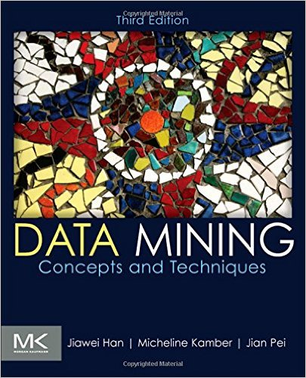
Textbook
Jiawei Han, Micheline Kamber and Jian Pei, Data Mining: Concepts and Techniques (3rd ed), Morgan Kaufmann, 2011

Slide 11
Course Work and Grading
Assignments and Exams
Written assign.: 15% (three expected)
Programming assign.: 20% (two expected)
Midterm exam: 30%
Final exam: 35%
For students taking 4th credit
Concrete instructions on the project next week
Piazza: https://piazza.com/class/j2pkefesw6u67z
Check your homework/exam scores: Compass

Slide 12
Why Data Mining?
The Explosive Growth of Data: from terabytes to petabytes
Data collection and data availability
Automated data collection tools, database systems, Web, computerized society
Major sources of abundant data
Business: Web, e-commerce, transactions, stocks, …
Science: Remote sensing, bioinformatics, scientific simulation, …
Society and everyone: news, digital cameras, YouTube
We are drowning in data, but starving for knowledge!
Notes:
Big data
Random data
Knowledge?

Slide 13
What is Data Mining?
Data mining (knowledge discovery from data)
Extraction of interesting (non-trivial, implicit, previously unknown and potentially useful) patterns or knowledge from huge amount of data
Alternative names
Knowledge discovery (mining) in databases (KDD), knowledge extraction, data/pattern analysis, data archeology, data dredging, information harvesting, business intelligence, etc.
Watch out: Is everything “data mining”?
Notes:
Query processing:
Let me know what nutrition the yogurt has.
Let me know why the yogurt is good for me.

Slide 14
Knowledge Discovery (KDD) Process
Knowledge
Pattern Evaluation
Typical database systems
Data Mining
Task-relevant Data
Data Warehouse
Selection
Data Cleaning
Data Integration
Databases

Slide 15
Example: Web Mining
Web mining usually involves
Data cleaning
Data integration from multiple sources
Warehousing the data
Data cube construction
Data selection for data mining
Data mining
Presentation of the mining results
Patterns and knowledge to be used or stored into knowledge-base

Slide 16
Example: Business Intelligence
Increasing potential
to support
business decisions
End User
Decision Making
Data Presentation
Business
Analyst
Visualization Techniques
Data Mining
Data
Analyst
Information Discovery
Data Exploration
Statistical Summary, Querying, and Reporting
Data Preprocessing/Integration, Data Warehouses
DBA
Data Sources
Paper, Files, Web documents, Scientific experiments, Database Systems

Slide 17
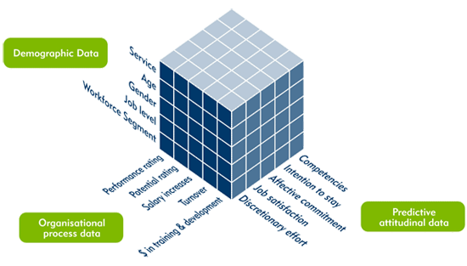
Data Mining Functions: (1) Generalization
Information integration and data warehouse construction
Data cube technology
Multidimensional concept description: Characterization and discrimination
Notes:
Information integration and data warehouse construction
Data cleaning, transformation, integration, and multidimensional data model
Data cube technology
Scalable methods for computing (i.e., materializing) multidimensional aggregates
OLAP (online analytical processing)
Multidimensional concept description: Characterization and discrimination
Generalize, summarize, and contrast data characteristics, e.g., dry vs. wet region

Slide 18
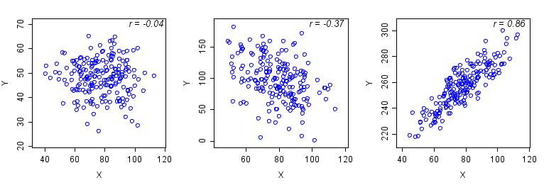
Data Mining Functions: (2) Pattern Discovery
Frequent patterns (or frequent itemsets)
What items are frequently purchased together in your Walmart?
A typical association rule
Diaper → Beer [0.5%, 75%] (support, confidence)
Support: the proportion of transactions in the dataset which contains the itemset (Diaper, Beer).
Confidence: the proportion of the transactions that contains Diaper which also contains Beer.
Association and Correlation Analysis

Slide 19
Data Mining Functions: (3) Classification
Classification and label prediction
Construct models (functions) based on some training examples
Describe and distinguish classes or concepts for future prediction
Ex. 1. Classify countries based on (climate)
Ex. 2. Classify cars based on (gas mileage)
Predict some unknown class labels
Typical methods
Decision trees, naïve Bayesian classification, support vector machines, neural networks, rule-based classification, pattern-based classification, logistic regression, …
Typical applications:
Credit card fraud detection, direct marketing, classifying stars, diseases, web-pages, …

Slide 20
Data Mining Functions: (4) Clustering
Unsupervised learning (i.e., class label is unknown)
Group data to form new categories (i.e., clusters), e.g., cluster houses to find distribution patterns
Principle: Maximizing intra-class similarity & minimizing interclass similarity

Slide 21
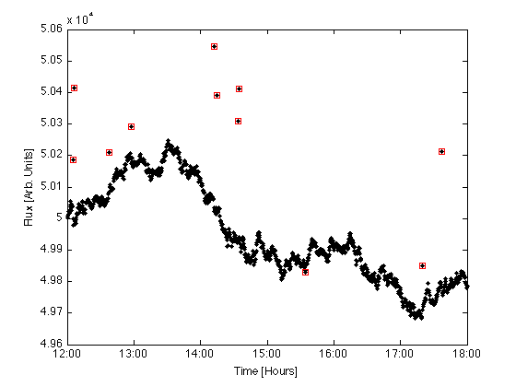
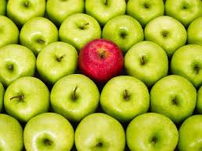
Data Mining Functions: (5) Outlier Analysis
Outlier analysis
Outlier: A data object that does not comply with the general behavior of the data
Methods: by product of clustering or regression analysis…
Useful in fraud detection, rare events analysis

Slide 22
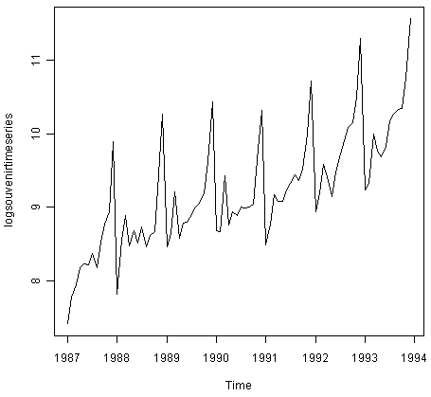
Data Mining Functions: (6) Sequential Pattern, Evolution Analysis
Sequence, trend and evolution analysis
Trend, time-series, and deviation analysis
e.g., regression and value prediction
Sequential pattern mining
e.g., buy digital camera, then buy large memory cards
Periodicity analysis
Motifs and biological sequence analysis
Approximate and consecutive motifs
Similarity-based analysis

Slide 23
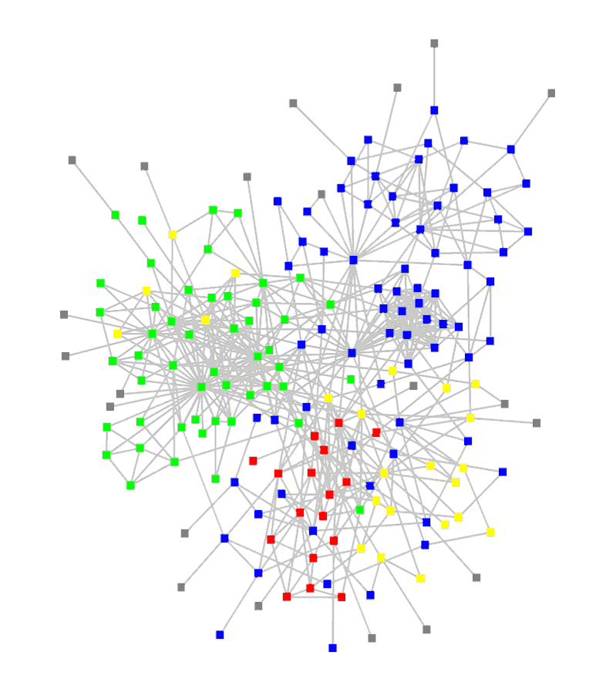
Data Mining Functions: (7) Structure and Network Analysis
Graph mining
Finding frequent subgraphs (e.g., chemical compounds), trees (XML), substructures (web fragments)
Information network analysis
Social networks: actors (objects, nodes) and relationships (edges)
e.g., author networks in CS, terrorist networks
Multiple heterogeneous networks
A person could be multiple information networks: friends, family, classmates, …
Links carry a lot of semantic information: Link mining
Web mining
Web is a big information network: from PageRank to Google
Analysis of Web information networks
Web community discovery, opinion mining, usage mining, …

Slide 24
Syllabus
Intro (1)
Know Your Data (2): Assign. 1
Data Preprocessing (2.5)
Data Warehousing & OLAP (1.5): Assign. 2
Data Cube Tech (2)
Mining Frequent Patterns and Associations (3+5): Assign. 3 and Midterm Exam
Classification (3.5+3.5): Assign. 4 and Assign. 5
Cluster Analysis (4): Final Exam
Discussion
Choose one company: Amazon, Yahoo!, Walmart, Google, Facebook, Twitter, Snapchat, Bloomberg, CNN…
Answer:
Given what data,
What to find?
Why?
How?

Slide 25
Applications
Web page analysis: classification, clustering, ranking
Collaborative analysis & recommender systems
Basket data analysis to targeted marketing
Biological and medical data analysis
Data mining and software engineering
Data mining and text analysis
Data mining and social and information network analysis

Slide 26
Multidimensional View of Data Mining
Data to be mined
Database data (extended-relational, object-oriented, heterogeneous), data warehouse, transactional data, stream, spatiotemporal, time-series, sequence, text and web, multi-media, graphs & social and information networks
Knowledge to be mined (or: Data mining functions)
Characterization, discrimination, association, classification, clustering, trend/deviation, outlier analysis, …
Descriptive vs. predictive data mining
Multiple/integrated functions and mining at multiple levels
Techniques utilized
Data-intensive, data warehouse (OLAP), machine learning, statistics, pattern recognition, visualization, high-performance, etc.
Applications adapted
Retail, telecommunication, banking, fraud analysis, bio-data mining, stock market analysis, text mining, Web mining, etc.
Amazon, Yahoo!, Walmart, Google, Facebook, Twitter, Snapchat, Bloomberg, CNN…

Slide 27
Research Challenges
Mining Methodology
Mining various and new kinds of knowledge
Mining knowledge in multi-dimensional space
Data mining: An interdisciplinary effort
Boosting the power of discovery in a networked environment
Handling noise, uncertainty, and incompleteness of data
Pattern evaluation and pattern- or constraint-guided mining
User Interaction
Interactive mining
Incorporation of background knowledge
Presentation and visualization of data mining results

Slide 28
Research Challenges (cont.)
Efficiency and Scalability
Efficiency and scalability of data mining algorithms
Parallel, distributed, stream, and incremental mining methods
Diversity of data types
Handling complex types of data
Mining dynamic, networked, and global data repositories
Data mining and society
Social impacts of data mining
Privacy-preserving data mining
Invisible data mining

Slide 29
History
1989 IJCAI Workshop on Knowledge Discovery in Databases
Knowledge Discovery in Databases (G. Piatetsky-Shapiro and W. Frawley, 1991)
1991-1994 Workshops on Knowledge Discovery in Databases
Advances in Knowledge Discovery and Data Mining (U. Fayyad, G. Piatetsky-Shapiro, P. Smyth, and R. Uthurusamy, 1996)
1995-1998 International Conferences on Knowledge Discovery in Databases and Data Mining (KDD’95-98)
Journal of Data Mining and Knowledge Discovery (1997)
ACM SIGKDD conferences since 1998 and SIGKDD Explorations
More conferences on data mining
PAKDD (1997), PKDD (1997), SIAM Data Mining (2001), (IEEE) ICDM (2001), WSDM (2008), etc.
ACM Transactions on KDD (2007)

Slide 30
Venues
Data mining and KDD (SIGKDD)
Conferences: ACM SIGKDD, IEEE ICDM, SIAM DM, PKDD, PAKDD, etc.
Journal: Data Mining and Knowledge Discovery, KDD Explorations, IEEE TKDE, ACM TKDD
Database systems (SIGMOD)
Conferences: ACM SIGMOD, ACM-PODS, VLDB, IEEE ICDE, EDBT, ICDT, DASFAA
Journals: ACM TODS/TOIS, JIIS, J. ACM, VLDB J., Info. Sys., etc.
AI & Machine Learning
Conferences: ICML, AAAI, IJCAI, COLT (Learning Theory), CVPR, NIPS, etc.
Journals: Machine Learning, Artificial Intelligence, IEEE PAMI, etc.
Web and IR
Conferences: SIGIR, WWW, CIKM, etc.
Journals: Internet and Web Information Systems
Statistics
Conferences: Joint Stat. Meeting, etc.
Journals: Annals of statistics, etc.
Visualization
Conference proceedings: CHI, ACM SIGGraph, etc.
Journals: IEEE Trans. visualization and computer graphics, etc.

Slide 31
Summary
Data mining: Discovering interesting patterns and knowledge from massive amount of data
A natural evolution of science and information technology, in great demand, with wide applications
A KDD process includes data cleaning, data integration, data selection, transformation, data mining, pattern evaluation, and knowledge presentation
Data mining functionalities: characterization, discrimination, association, classification, clustering, trend and outlier analysis, …
Data mining technologies and applications
Research challenges in data mining

Slide 32
References
Charu C. Aggarwal, Data Mining: The Textbook, Springer, 2015
E. Alpaydin. Introduction to Machine Learning, 2nd ed., MIT Press, 2011
R. O. Duda, P. E. Hart, and D. G. Stork, Pattern Classification, 2ed., Wiley-Interscience, 2000
U. Fayyad, G. Grinstein, and A. Wierse, Information Visualization in Data Mining and Knowledge Discovery, Morgan Kaufmann, 2001
J. Han, M. Kamber, and J. Pei, Data Mining: Concepts and Techniques. Morgan Kaufmann, 3rd ed. , 2011
T. Hastie, R. Tibshirani, and J. Friedman, The Elements of Statistical Learning: Data Mining, Inference, and Prediction, 2nd ed., Springer, 2009
T. M. Mitchell, Machine Learning, McGraw Hill, 1997
P.-N. Tan, M. Steinbach and V. Kumar, Introduction to Data Mining, Wiley, 2005 (2nd ed. 2016)
I. H. Witten and E. Frank, Data Mining: Practical Machine Learning Tools and Techniques with Java Implementations, Morgan Kaufmann, 2nd ed. 2005
Mohammed J. Zaki and Wagner Meira Jr., Data Mining and Analysis: Fundamental Concepts and Algorithms 2014

Slide 33
Discussion
Given a task – design a machine that can find the only outlier from a set of concepts, …
Q: apple, banana, eggplant, strawberry
A: eggplant
How?

Slide 34
Discussion
Given self-introductory one-minute one-page text data of your classmates, …
Q:?
A:?
How?
Write down your self-intro and what you want to do

